Slide 1







Emerging skills and technologies
Manujith P
28-11-2020

Slide 2


Table of Contents
Executive Summary
Introduction
Methodology
Results
Visualization – Charts
Dashboard
Discussion
Findings & Implications
Conclusion
Appendix

Slide 3

Executive Summary
This presentation will present the analysis report that investigates the emerging skill set and technologies of the IT industry.
The primary aim of the analysis is to identify the emerging trends in the IT industry pertaining to -
Programming languages
Databases
Software platforms (IDEs)
Web frames
The current trends are also analyzed for comparison with expected future trends.

Slide 4

Introduction
The main purpose of this analysis is to keep up with the changing tools used in the IT industry.
This practice is necessary to identify and hire future employees and train current employees in these tools to keep them up to date.
The required data is collected from various sources -
Job postings
Training portals
Surveys

Slide 5

Methodology
The required data for analysis is collected from
GitHub jobs
IBM website
Stack Overflow
The information on the number of job postings for software tools was extracted by accessing GitHub Job APIs
The information on the annual salaries of professionals working with certain software tools was accessed by web scrapping the IBM website.
The required data set for this analysis comes from a survey conducted by Stack Overflow which they have open sourced.

Slide 6
Methodology
Once the data is collected, data wrangling is performed to -
Find missing values
Find duplicate values
Remove duplicates
Determine the missing values
Normalize the data
After the data set is cleaned, an exploratory analysis is conducted to identify distribution of data, outliers in any fields and correlations between different fields.
The data is visualized to view the distribution of data, relationship between different fields, comparison and composition of data.
Finally dashboards are created to identify trends.

Slide 7
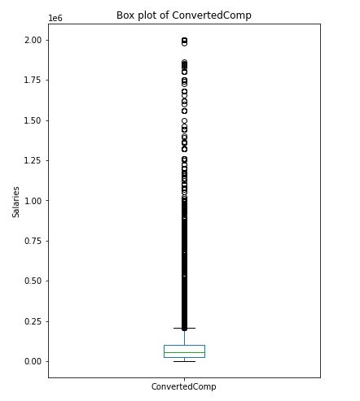
Result
After data wrangling, the following observations were made –
Most respondents earned salaries within 250,000 USD

Slide 8
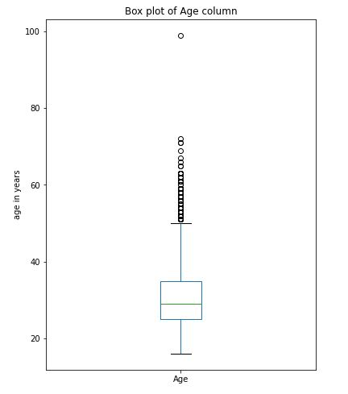
Result
After data wrangling, the following observations were made –
Most respondents were from 20 to 45 years of age

Slide 9
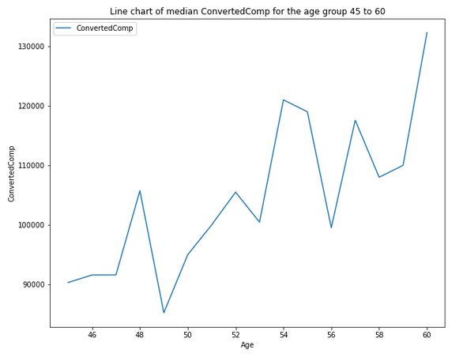
Result
After data wrangling, the following observations were made –
There is a positive correlation between the salary and age of the respondent.
This makes sense as the respondent is older in age, the more experienced he/she is, hence a higher pay cheque.

Slide 10
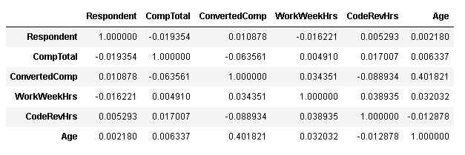
Result
After data wrangling, the following observations were made –
The below table gives the correlation between different fields from the data set.
And once again we see that Age has the strongest correlation with salary (ConvertedComp)

Slide 11
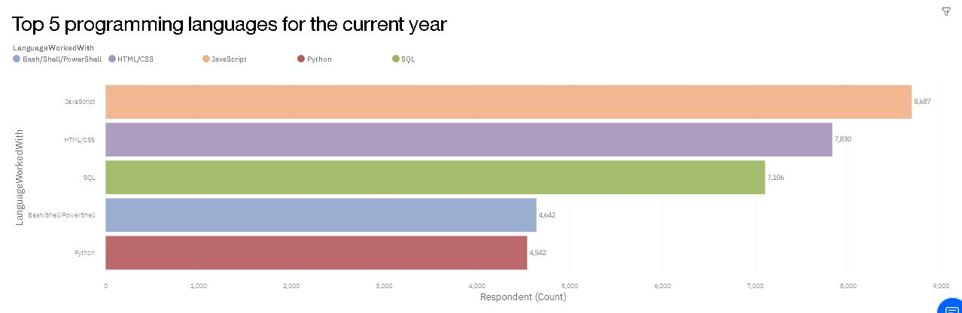
Programming language trends

Slide 12
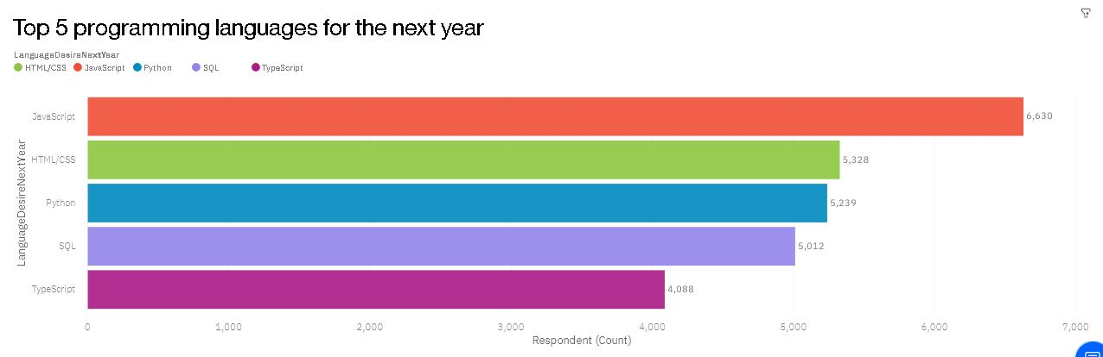
Programming language trends

Slide 13
Programming language trends – Findings & implications
Findings
Java scrip and HTML/CSS remain the most in demand programming language
Increasing number of professionals want to learn python and type script
Implications
Hiring and training professionals in Java and HTML will remain a top priority
Hiring and training professionals in python can help the company keep up with market trends

Slide 14
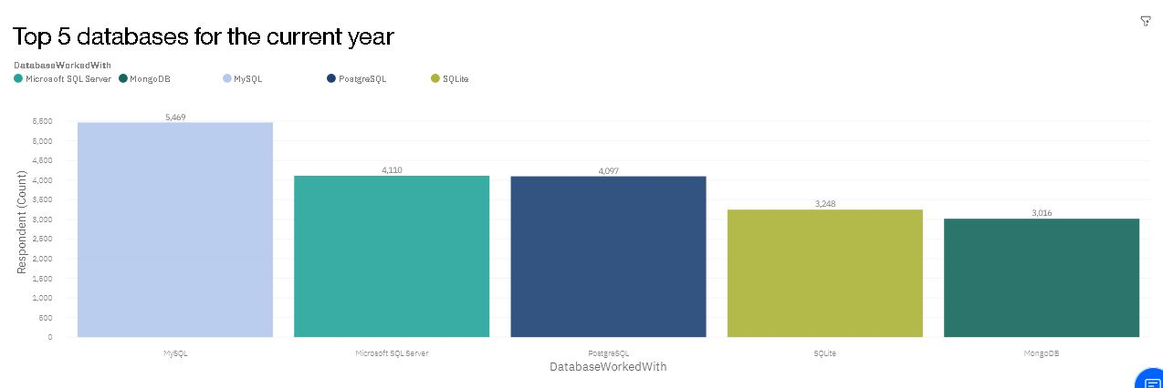
Database trends

Slide 15
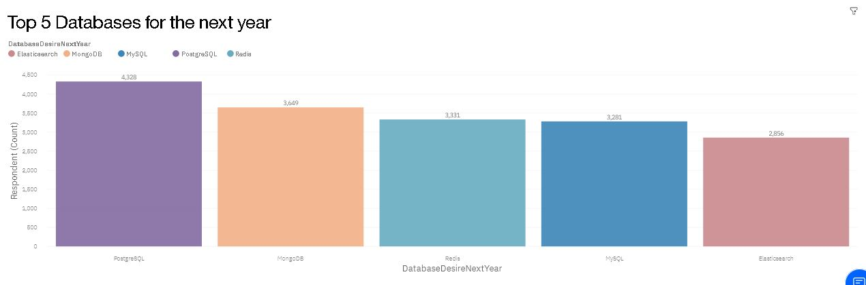
Database trends

Slide 16
Database trends – Findings & implications
Findings
MySQL is the most widely used database
Increasing number of professionals want to work with PostgreSQL and MongoDB
Implications
Hiring and training employees in MySQL will remain as it is, since most employees already work with MySQL.
Hiring and training employees in PostgreSQL and MongoDB must be a priority henceforth.

Slide 17

Dashboard
The below link will take you to the Dashboards created on Cognos Analytics for this presentation –
Click here

Slide 18
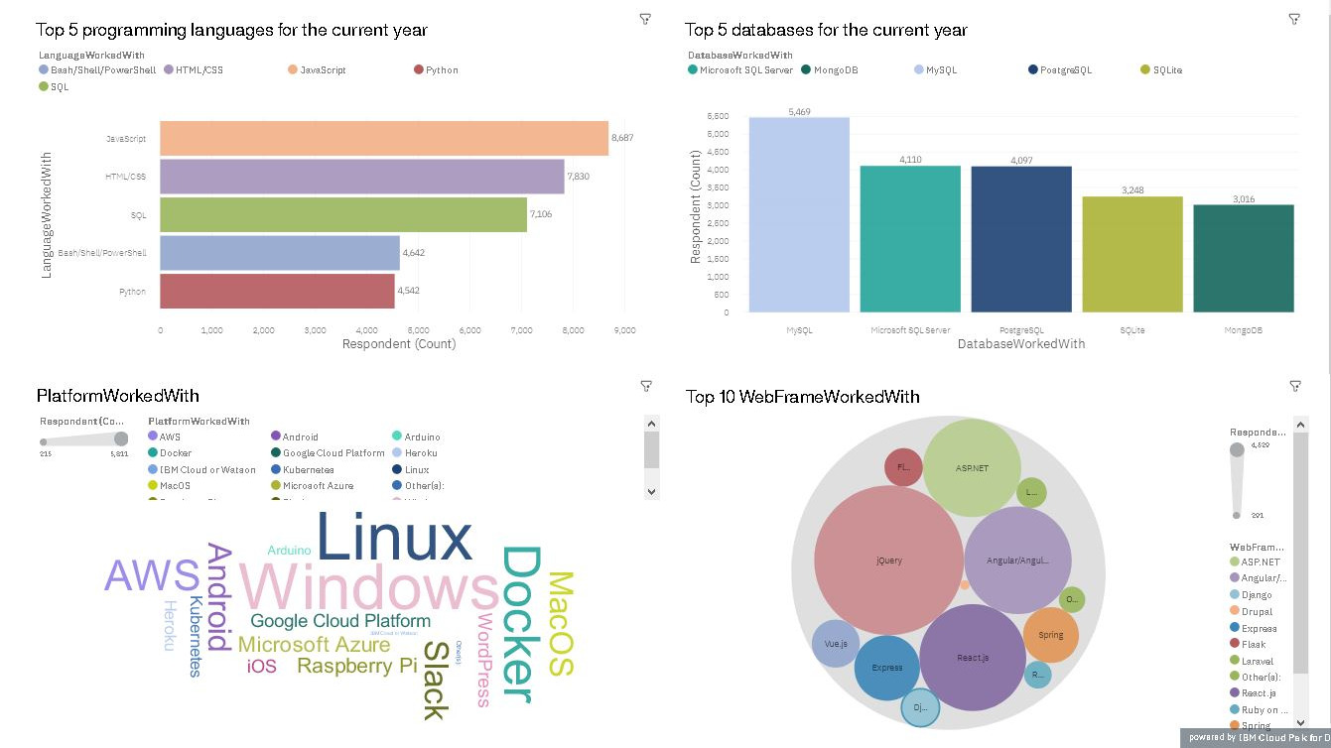
Dashboard – Current technology usage

Slide 19
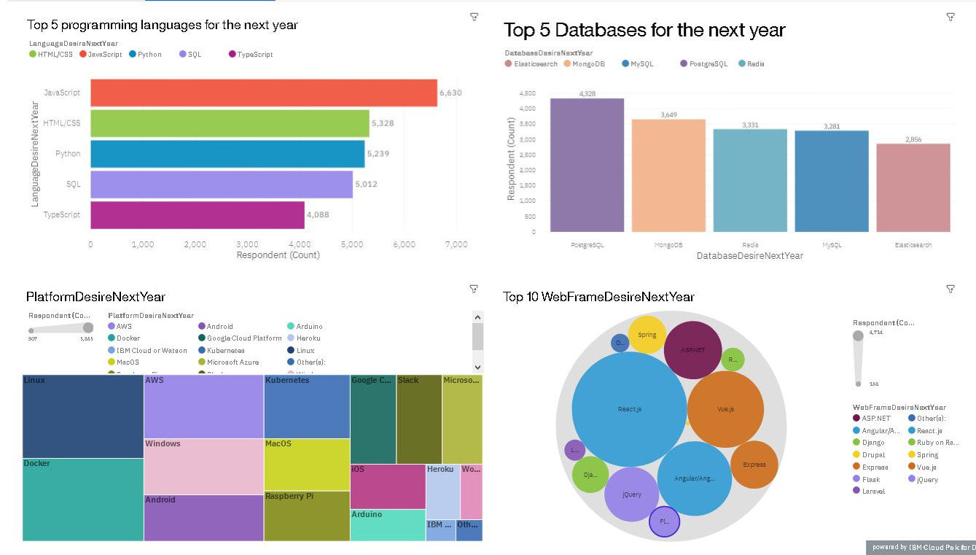
Dashboard – Future technology trend

Slide 20
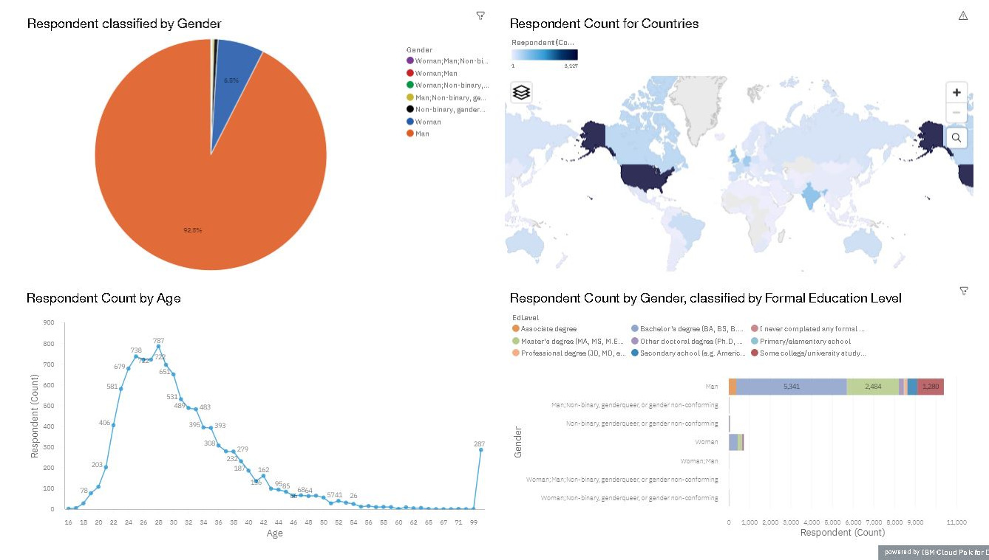
Dashboard – Demographics

Slide 21
Discussion
The main purpose of the analysis is to identify emerging technology trends in the IT industry.
The trends have been analyzed and visualized.
Most respondents earn within 250,000 USD and are from 20 to 45 years of age, this observation confirms the relevance of our analysis.
It is also important to note that most respondents are men and from the United States of America.

Slide 22
Overall findings and implications
Findings
Java scrip, HTML/CSS and MySQL remain the most in demand tools
Increasing number of professionals want to learn python, type script, PostgreSQL and MongoDB
Linux, Windows and Docker are the most commonly used software platforms
React, AngularJS and JQuery are the most commonly used Web frameworks
Implications
Hiring and training professionals in Java, HTML and MySQL will remain a top priority
Hiring and training professionals in python, PostgreSQL and MongoDB can help the company keep up with market trends
Professionals used to Linux and windows, and proficient in React and JQuery are preferred

Slide 23

Conclusion
All in all the analysis indicates the following tools to be the most in demand software applications –
Programming languages -
JavaScript
HTML/CSS
Python
Databases -
PostgreSQL
MongoDB
MySQL
Software Platforms -
Windows
Linux
Docker
Web Frameworks -
JQuery
React
AngularJS

Slide 24

Appendix
There are some interesting observations from the GitHub job postings and the popular languages data set that is worth noting.

Slide 25
GitHub job postings
GitHub job postings data has something to add
The number of job postings for C and Java are the highest, although C wasn’t in the top 5 programming languages in the analysis

Slide 26
Popular programming languages
From the popular programming languages data, we see that professionals who work with Swift, python and C++ are the highest paid
This piece of information is interesting as Swift and C++ weren’t in the top 5 programming languages in the conducted analysis

